Slide 1
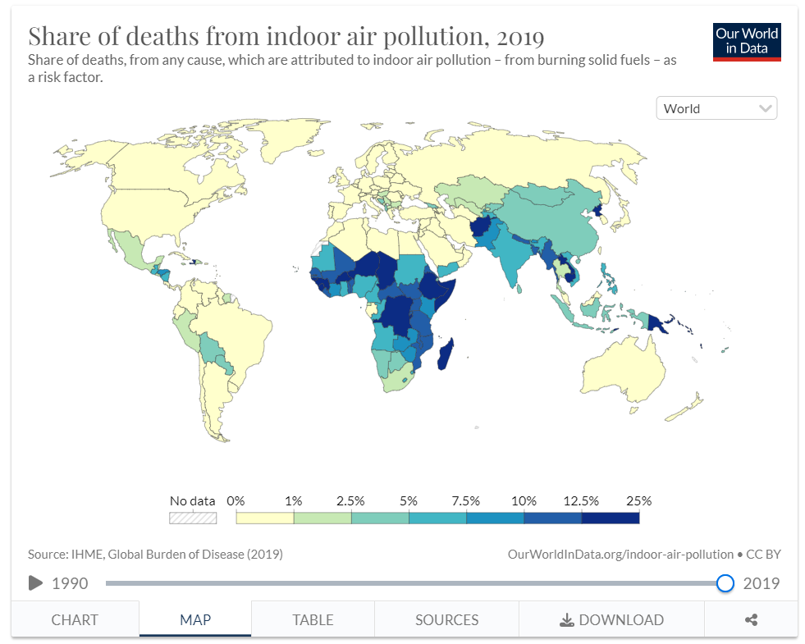
Indoor Air Pollution
Share of Deaths, 2019
Notes:
Share of all-cause deaths attributed to indoor air pollution. Over 10% and as high as 25% in much of Sub-Saharan Africa and parts of Asia.

Slide 2
Household air pollution from cooking with solid burning fuels kills millions every year worldwide, mostly in Sub-Saharan Africa and parts of Asia.
Women and children are the majority of these deaths.
The Clean Cooking Alliance, an NGO operating with the support of the United Nations Foundation, launched in 2010 with the mission of transforming and saving lives by helping people convert to modern fuels and stoves.
Notes:
According to CCA 2021 report, 400M people have gained access to clean cooking fuels and technologies since 2010.
Global deaths due to household air pollution down from about 3M/year in 2010 to ~2.3M/year in 2020

Slide 3
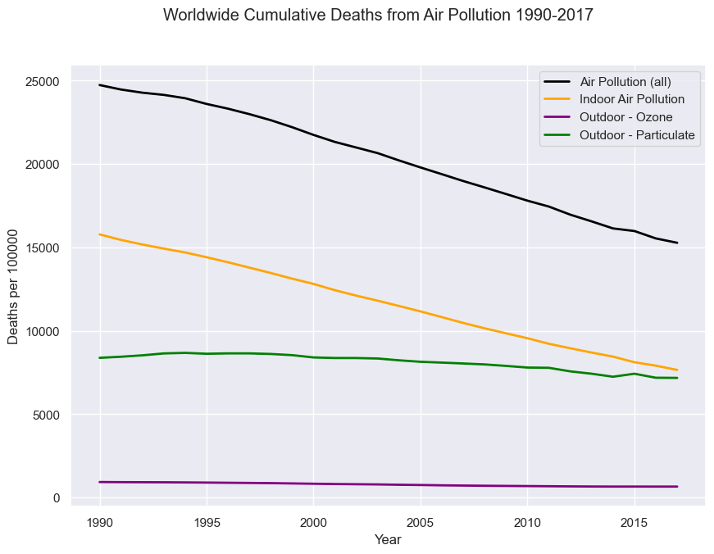
Notes:
Even though deaths due to household air pollution are on the decline, there are still millions of death each year that are attributable to this and that could be largely prevented by widespread adoption of clean cooking fuels and devices.

Slide 4
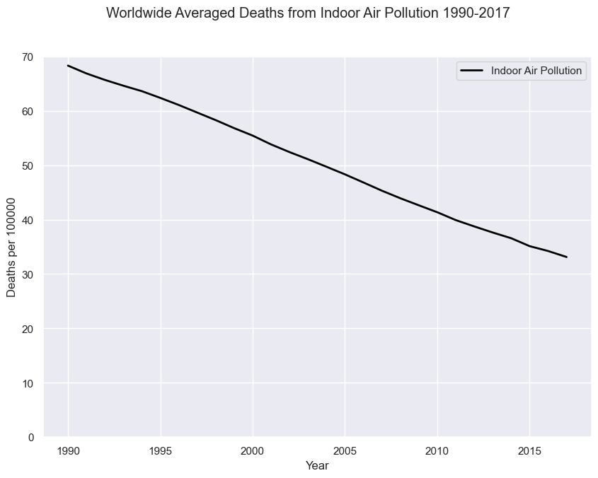

Slide 5
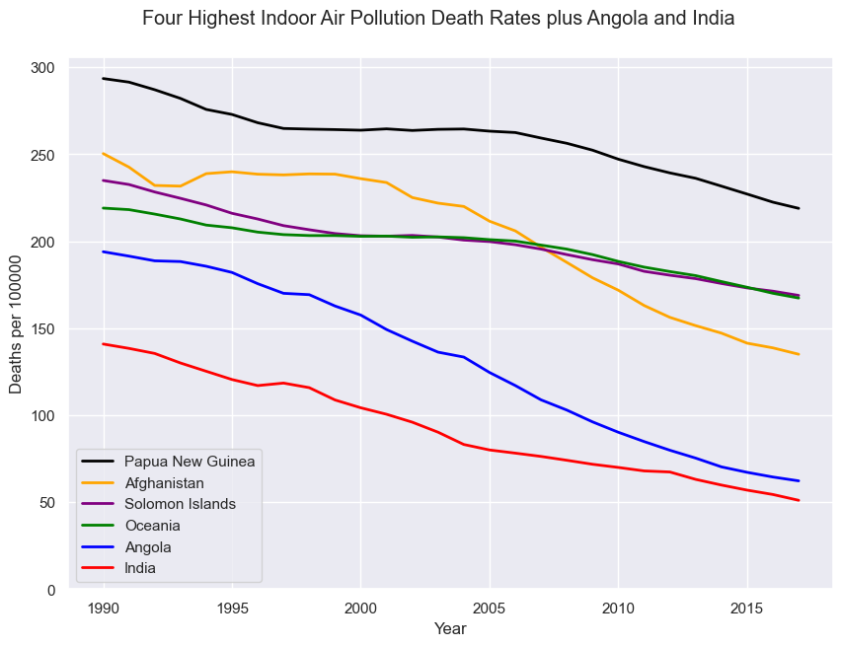
Notes:
My research identified Angola and India as two examples of countries that have large NGO program focus on clean cooking (Angola) and having major government programs to increase adoption (India), so I wanted to show them on this trend plot to see how they compare to the countries with the highest death rates,

Slide 6
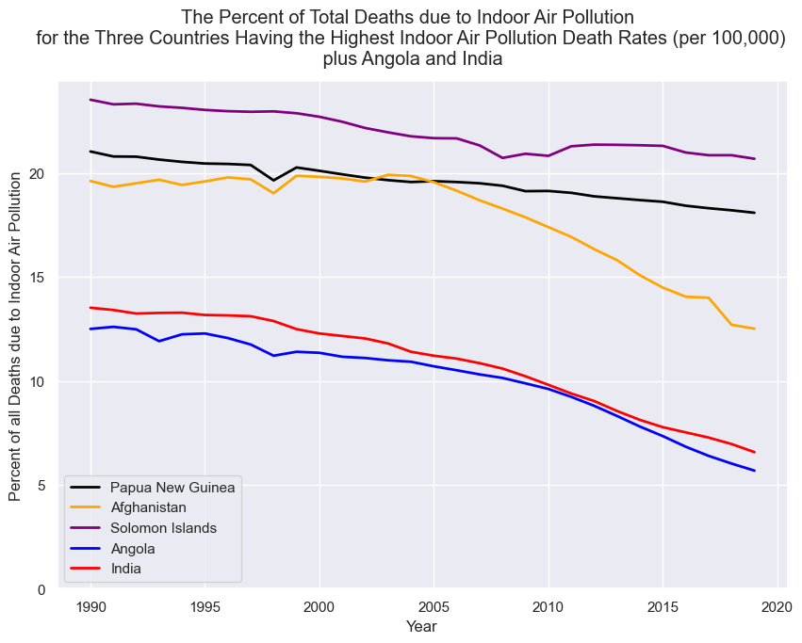
Notes:
The countries from the previous slide (those with the highest death rates from indoor air poll) but shown with respect to the percent of all deaths due to indoor air pollution in that country. Of note is the decrease in the share of deaths due to household air pollution in Afghanistan around the time that the war starts there…

Slide 7
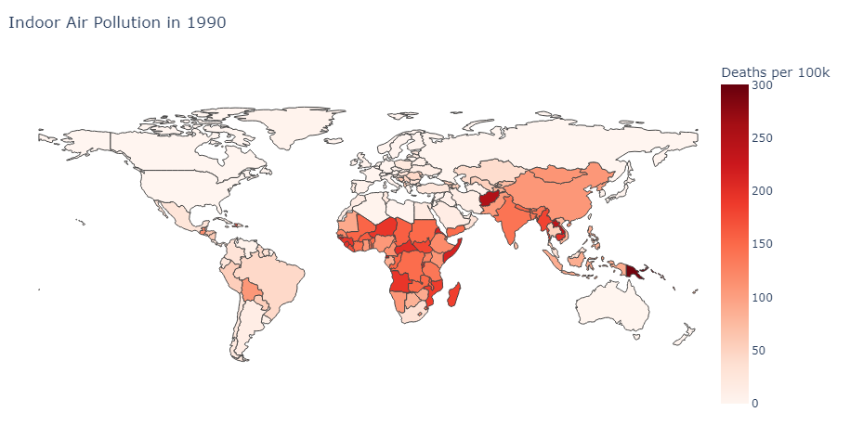

Slide 8
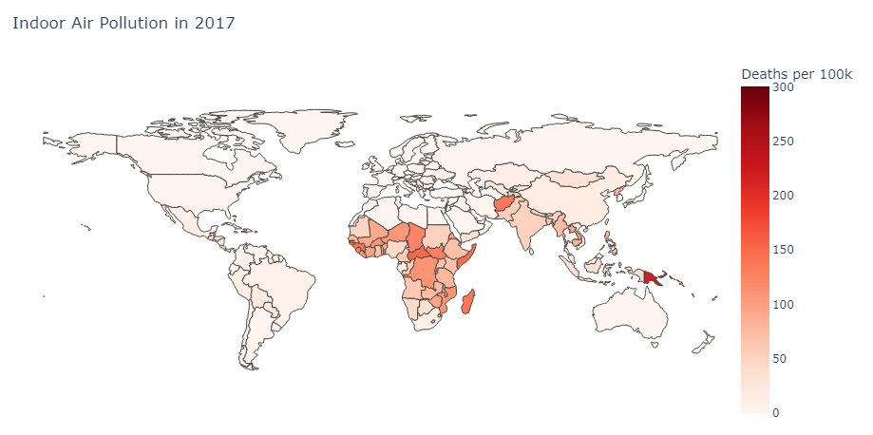
Notes:
A dramatic illustration of the decrease in death rates between 1990 and 2017, but also the geographic concentration of where indoor air pollution is a huge problem.

Slide 9
Future Analysis
Investigate trends as clean cooking adoption continues and increases.
Compare clean cooking adoption rates and death due to indoor air pollution rates. Is there a lag? Do they trend together at all, as one would assume?

Slide 10
Dataset Sources
https://www.kaggle.com/datasets/akshat0giri/death-due-to-air-pollution-19902017
https://ourworldindata.org/indoor-air-pollution
Other Knowledge Sources
https://cleancooking.org/
https://www.who.int/news/item/20-01-2022-who-publishes-new-global-data-on-the-use-of-clean-and-polluting-fuels-for-cooking-by-fuel-type

